Slide 1
Advanced Data Processing Concepts

Slide 2
Operations and Transformations
Content:
Operations: Actions that can be performed on data (e.g., map, reduce)
Transformations: Operations that produce a new dataset (e.g., filter, join)
Example:
Operation: map() function in Spark that applies a function to each element of an RDD (Resilient Distributed Dataset)
Transformation: filter() in Spark that creates a new RDD with elements that satisfy a condition

Slide 3
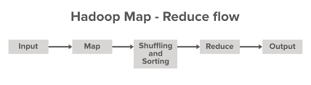

Slide 4
Fine-Grained Transformations and Scalability
Content:
Fine-Grained Transformations: Detailed operations that allow for precise control over data (e.g., nested loops)
Scalability: Ability of a system to handle growth in data volume or complexity
Example:
Fine-Grained: Applying a series of small transformations to filter and aggregate data
Scalability: Partitioning data into chunks that can be processed independently across nodes in a cluster
Notes:
In Apache Spark, transformations are classified into two categories based on their granularity: fine-grained and coarse-grained transformations. Understanding the difference between these two types is crucial for optimizing performance and resource usage in Spark applications.
Fine-Grained Transformations
Definition: Fine-grained transformations operate on individual elements of a dataset. They involve operations that apply to a small portion of the data at a time.
Examples: map, filter, flatMap.
Characteristics:
They tend to create a lot of small tasks, which can lead to overhead in task scheduling and management.
Each task processes a small number of records, which may require more frequent communication between the executor and the driver.
Fine-grained transformations can be useful for operations that require a high degree of customization for each data element.
Coarse-Grained Transformations
Definition: Coarse-grained transformations apply operations to larger chunks of data, such as whole partitions or the entire dataset.
Examples: reduceByKey, groupByKey, aggregate.
Characteristics:
They create fewer, larger tasks, which can reduce the overhead of task scheduling and improve performance.
These transformations often require less communication overhead, as they can process data in larger batches.
Coarse-grained transformations are generally more efficient for operations that can be expressed in terms of aggregating or combining data.

Slide 5
Parallelism by Partitioning Data
Content:
Parallelism: Concurrent execution of tasks to speed up processing
Partitioning: Dividing data into smaller segments that can be processed in parallel
Example:
In Spark, an RDD is divided into partitions which are processed in parallel across different nodes
Notes:
https://medium.com/@sc1abhis/spark-data-partitioning-boosting-performance-through-parallel-processing-202c869f7999

Slide 6
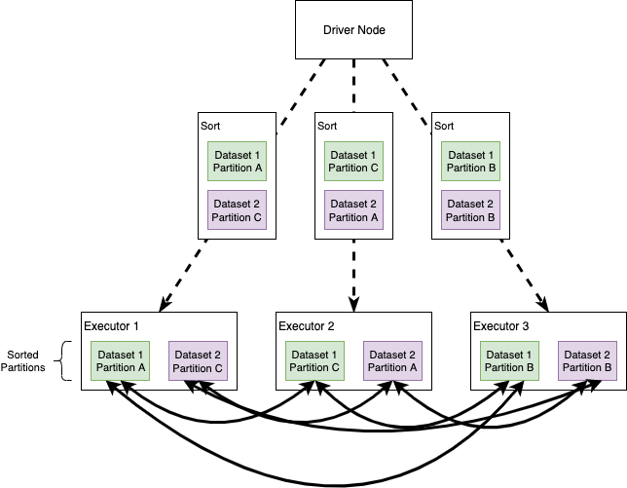

Slide 7
Pipelining
Content:
Pipelining: Technique where multiple data processing stages are connected in sequence
Example:
In Spark, a sequence of transformations like map followed by filter is pipelined to create an efficient processing pipeline

Slide 8
Lazy Execution, Lineage, DAG, and Fault Tolerance
Content:
Lazy Execution: Operations are not executed until an action is performed
Lineage: Tracking of the sequence of operations to recompute lost data
DAG (Directed Acyclic Graph): Graph representing the sequence of computations
Fault Tolerance: Mechanism to recover from failures using lineage information
Example:
Lazy Execution: Spark delays execution of transformations until an action like collect() is called
DAG: Spark uses DAGs to keep track of stages and tasks in a computation

Slide 9
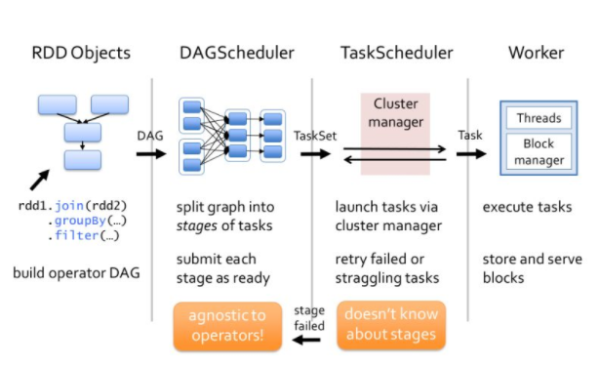
Notes:
https://www.linkedin.com/pulse/understanding-directed-acyclic-graph-dag-saikrishna-cheruvu-

Slide 10
SPARK Based Libraries and Packages
Content:
Overview of libraries and packages for different functionalities
MLlib: Machine Learning library
GraphX: Graph processing library
Spark SQL: SQL and DataFrame library
Spark Streaming: Real-time data processing
Example:
MLlib: Performing machine learning tasks like classification and clustering
Spark SQL: Running SQL queries on structured data

Slide 11


